Slide 1
SQL Boot camp
Instructor: Kashif Saeed

Slide 2
Agenda
Database Architecture
SQL Syntax – DML only
Understanding ER models from Querying perspectives
Understanding Dimensional models from Querying perspectives

Slide 3
SQL for an Analytics person
Whether you are a Data Analyst, Data Engineer, or Data Scientist, SQL will be required in almost all Analytics job roles
You will need to learn how to consume relational, NoSQL, web log files, JSON or XML files, and Hadoop data
You will seldom be designing databases or writing DDL statements; hence our focus is DML only for this training

Slide 4
Database Architecture

Slide 5
Database Architecture
RBDMS - is a software responsible for reading and writing the data
Database Server - is the server on which RDBMS software is installed
Storage – is where actual data resides
The Database server and Storage should be in the same data center, and possibly the same subnet
Quality of Storage and bandwidth of network between Database Server and Storage play an important role in database performance

Slide 6
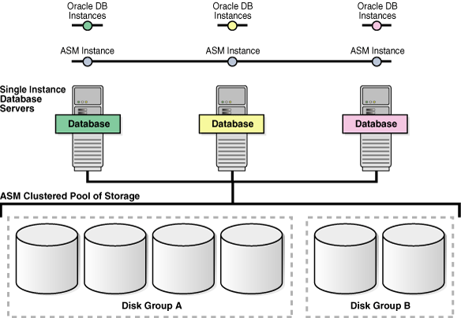
Database Architecture

Slide 7
Few Other technologies that you should know about
Database Appliances
Data Federation/Virtualization
In-memory databases
NoSQL databases

Slide 8
Basic SQL - DML

Slide 9
SQL Syntax
SELECT column_name(s) FROM table_name WHERE condition GROUP BY column_name(s) HAVING condition ORDER BY column_name(s);

Slide 10
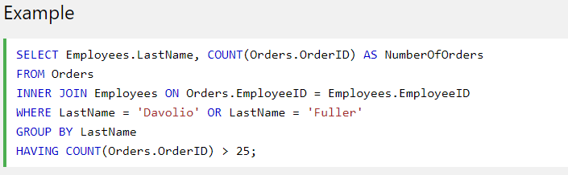
Basic SQL Example

Slide 11
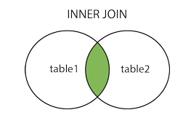
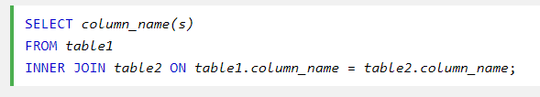
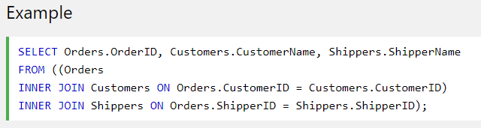
INNER JOIN Syntax
Source: https://www.w3schools.com

Slide 12
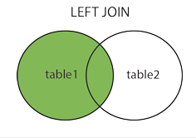
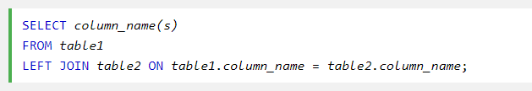
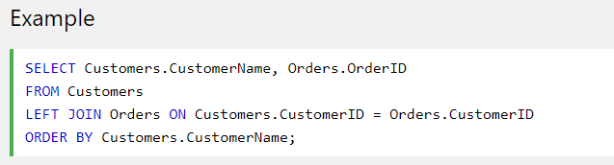
LEFT OUTER JOIN Syntax
Source: https://www.w3schools.com

Slide 13
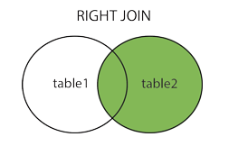
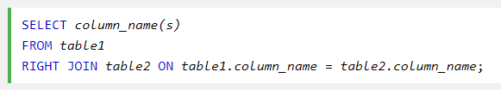
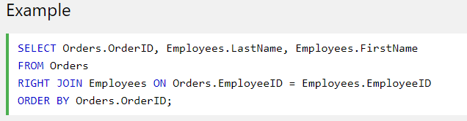
RIGHT OUTER JOIN Syntax
Source: https://www.w3schools.com

Slide 14
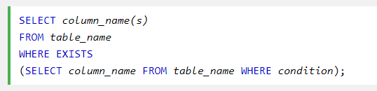
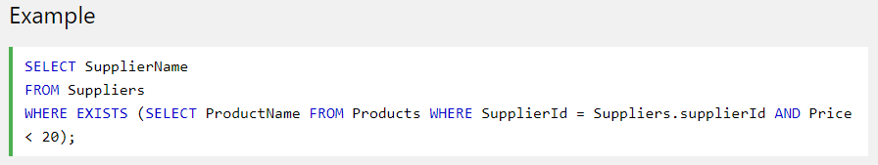
EXIST Operator
The EXISTS operator is used to test for the existence of any record in a subquery.
The EXISTS operator returns true if the subquery returns one or more records.

Slide 15
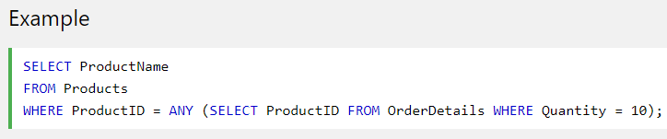
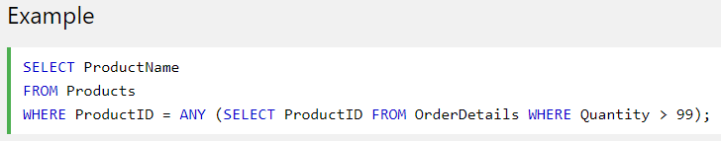
ANY and ALL Operators
The ANY and ALL operators are used with a WHERE or HAVING clause
The ANY operator returns true if any of the subquery values meet the condition
The ALL operator returns true if all of the subquery values meet the condition.

Slide 16
IN vs. ANY vs. ALL
IN will do an Equality comparison ONLY
SELECT empno, sal FROM emp WHERE sal IN (2000, 3000, 4000);
Will return employees where Salary is exactly 2000, 3000, or 4000
SELECT empno, sal FROM emp WHERE sal > ALL (2000, 3000, 4000);
Will return employees where Salary is greater than 4000
SELECT empno, sal FROM emp WHERE sal > ANY (2000, 3000, 4000);
Will return employees where Salary is greater than 2000 OR 3000 OR 4000

Slide 17
Understanding ER Models from Querying Perspective

Slide 18
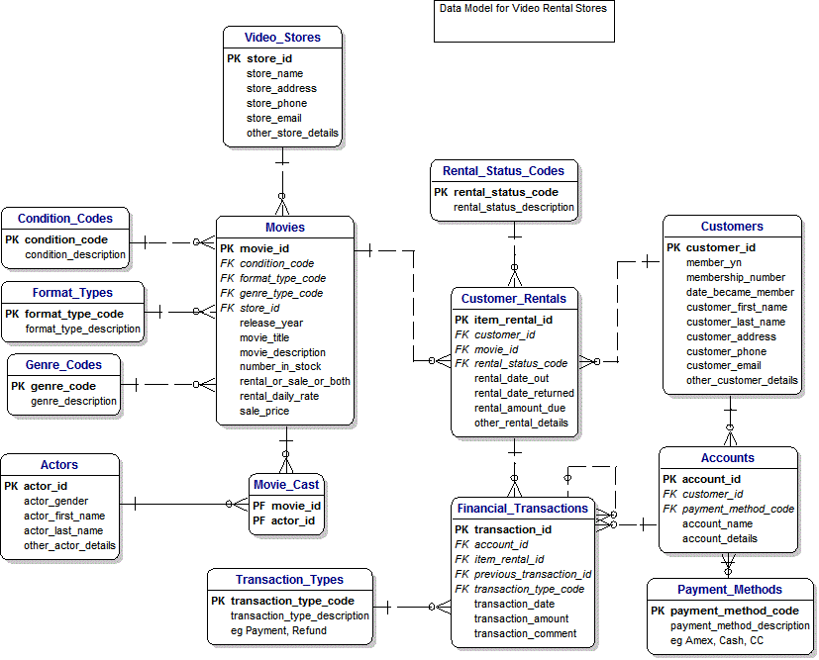
Identifying ER Models
ER models typically will have:
A lot of tables
Joins all over the place
A combination of inner and outer joins
No symmetry in terms of cardinalities

Slide 19
ER Models - SQL Perspective
The Maximum Cardinality does not mean anything when you’re writing SQL
The Minimum Cardinality means the possibility of an outer join. However, we will base the determination of using an Outer join based on the data rather than Minimum Cardinality
When writing SQL, do not implement all joins
Remember that each unnecessary join will limit the results you will get
Only relevant information that you get looking at ER model is what columns are used to join tables
Your Derived/Intersection tables are typically your starting point for writing SQL

Slide 20
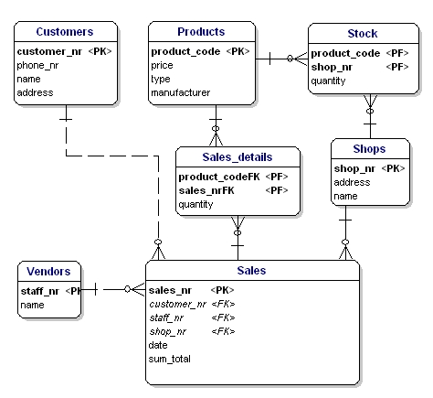
ER Model – Example 1

Slide 21
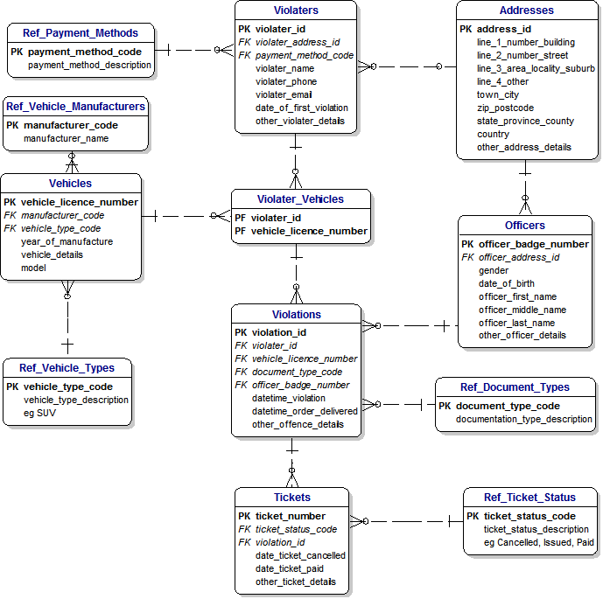
ER Model – Example 2

Slide 22
Understanding Dimensional Models from Querying Perspective

Slide 23
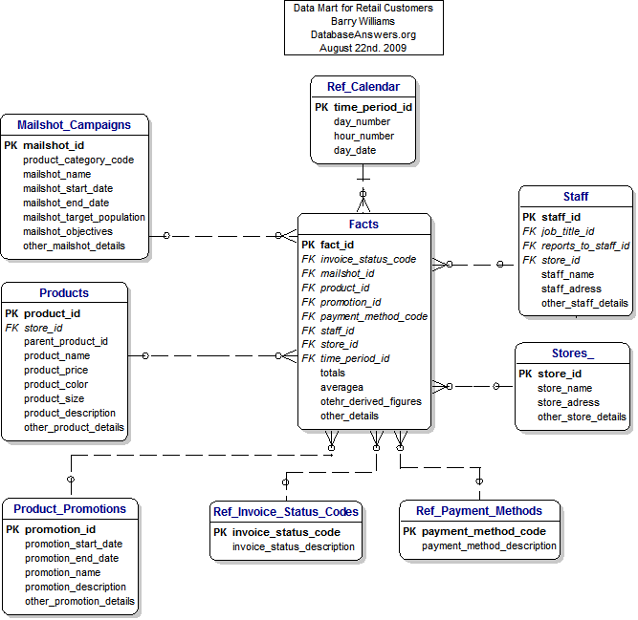
Identifying Dimensional Models
Dimensional models will have:
Fact tables and Dimension tables
All dimension tables joining to Fact table with no joins between dimension tables
No outer joins (if Null handling is properly implemented)
Symmetrical joins ending in many on Fact table

Slide 24
Dimensional Models - SQL Perspective
The Cardinalities do not mean anything when you’re writing SQL statements
No OUTER joins if dimension models are designed properly
When writing SQL, the Fact table drives your query
Dimension tables only provide context of analysis
Whether your SQL has one join or all joins, the outcome should not be different
Never write a SQL statement that goes across multiple fact tables

Slide 25
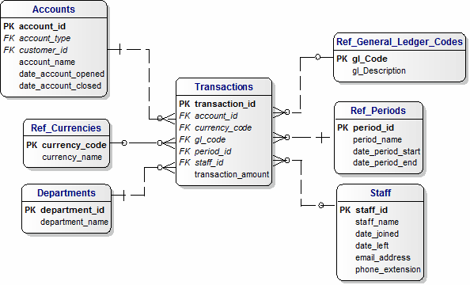
Dimensional Model – Example 1

Slide 26
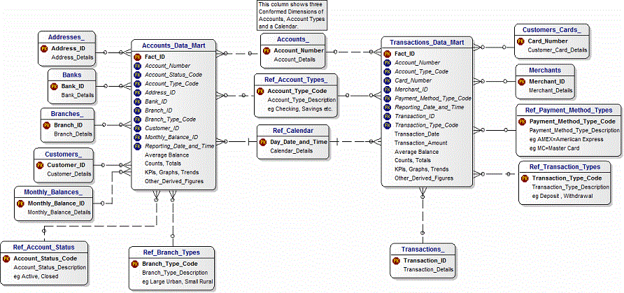
Dimensional Model – Example 2

Slide 27
Important Performance tips
Join using ON options are supposedly more efficient that joins with conditions as WHERE parameters
It is recommended that you not use RIGHT OUTER JOIN since a query can always be rewritten to use LEFT OUTER JOIN which tends to be more portable and easier to read

